Slide 1
FidelityFX CAS
Lou Kramer, Developer Technology Engineer, AMD

Slide 2
Legal
This presentation contains forward-looking statements concerning Advanced Micro Devices, Inc. (AMD) including, but not limited to, the features, functionality, performance, availability, timing, pricing, expectations and expected benefits of AMD’s current and future products, which are made pursuant to the Safe Harbor provisions of the Private Securities Litigation Reform Act of 1995. Forward-looking statements are commonly identified by words such as "would," "may," "expects," "believes," "plans," "intends," "projects" and other terms with similar meaning. Investors are cautioned that the forward-looking statements in this presentation are based on current beliefs, assumptions and expectations, speak only as of the date of this presentation and involve risks and uncertainties that could cause actual results to differ materially from current expectations. Such statements are subject to certain known and unknown risks and uncertainties, many of which are difficult to predict and generally beyond AMD's control, that could cause actual results and other future events to differ materially from those expressed in, or implied or projected by, the forward-looking information and statements. Investors are urged to review in detail the risks and uncertainties in AMD's Securities and Exchange Commission filings, including but not limited to AMD's Quarterly Report on Form 10-Q for the quarter ended March 30, 2019.

Slide 3

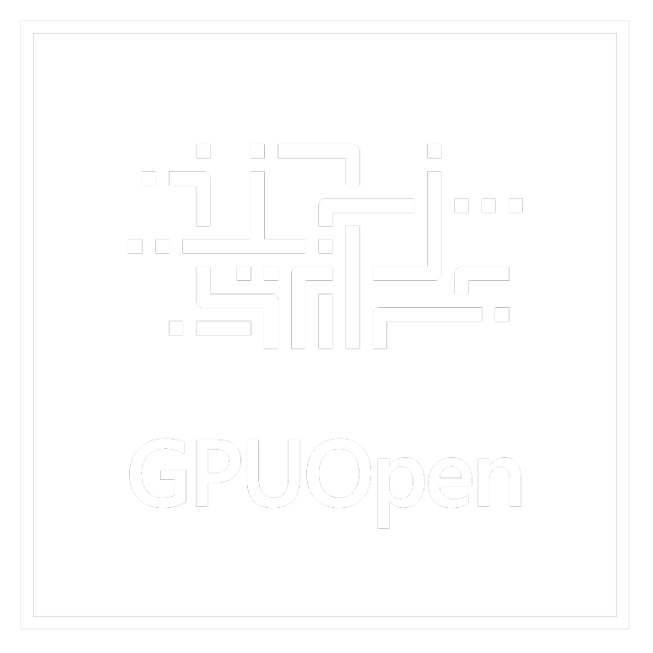
Group of image quality-enhancing techniques developed
by AMD
Hosted on GPUOpen under
the MIT license

Slide 4
Group of image quality-enhancing techniques developed
by AMD
Hosted on GPUOpen under
the MIT license
This talk will only cover Contrast Adaptive Sharpening (CAS).

Slide 5
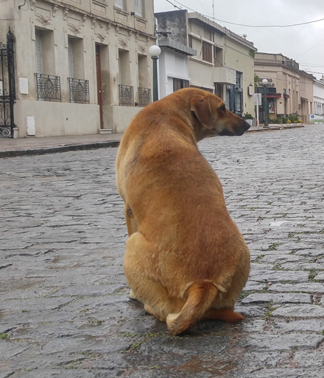
Group of image quality-enhancing techniques developed
by AMD
Hosted on GPUOpen under
the MIT license
This talk will only cover Contrast Adaptive Sharpening (CAS).

Slide 6

Group of image quality-enhancing techniques developed
by AMD
Hosted on GPUOpen under
the MIT license
This talk will only cover Contrast Adaptive Sharpening (CAS).

Slide 7
Agenda
Overview
Algorithm
Integration
Input
Performance
Examples
Q&A

Slide 8
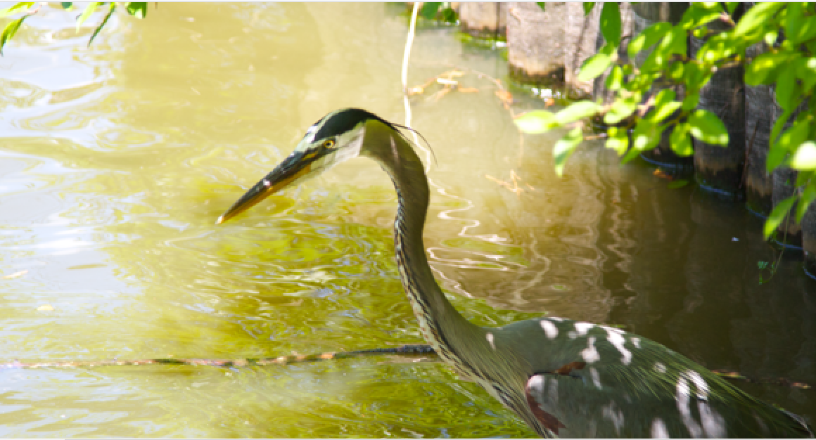
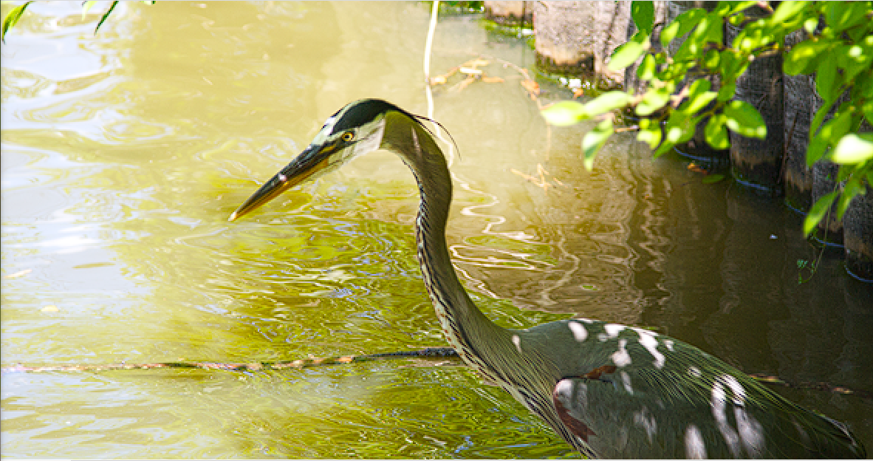
Overview
Contrast Adaptive Sharpening (CAS)
For sharpening and optionally upsampling
Enhance sharpness and local high-frequency contrast

Slide 9
Overview
Contrast Adaptive Sharpening (CAS)
For sharpening and optionally upsampling
Enhance sharpness and local high-frequency contrast
No CAS

Slide 10
Overview
Contrast Adaptive Sharpening (CAS)
For sharpening and optionally upsampling
Enhance sharpness and local high-frequency contrast
CAS

Slide 11
Overview
Contrast Adaptive Sharpening (CAS)
For sharpening and optionally upsampling
Enhance sharpness and local high-frequency contrast
Created to provide natural sharpness without artifacts with only low overhead

Slide 12
Overview
Contrast Adaptive Sharpening (CAS)
For sharpening and optionally upsampling
Enhance sharpness and local high-frequency contrast
Created to provide natural sharpness without artifacts with only low overhead
Upsampling feature was designed for Dynamic Resolution Scaling (DRS)
  With DRS render resolution can change per frame
  → use CAS to sharpen and upsample to the fixed output resolution, then composite full resolution UI over CAS output
  This happens all in one compute dispatch 😊

Slide 13

Upsample from 440x512 to 880x1024
using bicubic

Slide 14

Upsample from 440x512 to 880x1024
using CAS

Slide 15
When to use CAS?
For sharpening purposes
  E.g. as post-TAA sharpener
  After other ‚softener‘ passes to get some of the contrasts back
  After scaling from lower resolution when CAS is used in the sharpen-only version
Sharpening + Scaling
  As a Dynamic Resolution Scaling option
→ Everytime when you think it improves image quality ☺ Best is to just try it out!

Slide 16
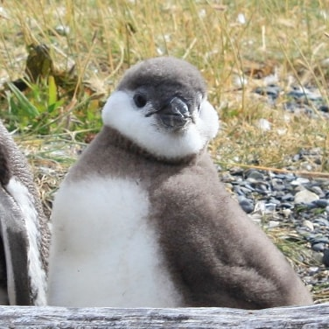
Algorithm

Slide 17
Algorithm - Overview
CAS is a spatial only filter.
It uses the minimal nearest 3x3 source texel window for filtering.
Final filter is of form while the centre pixel is the output pixel.
Weight w is computed per pixel, adapting to local contrast.
 | w
w | 1 | w
 | w

Slide 18
How to compute weight w?
Light color: 0.95, 0.75, 0.6
Middle color: 0.9, 0.4, 0.1
Dark color: 0.75, 0.25, 0.05

Slide 19
How to compute weight w?
Light color: 0.95, 0.75, 0.6
Middle color: 0.9, 0.4, 0.1
Dark color: 0.75, 0.25, 0.05

Slide 20
Base sharpening amount
Light color: 0.95, 0.75, 0.6
Middle color: 0.9, 0.4, 0.1
Dark color: 0.75, 0.25, 0.05
CAS fetches a ‘circle‘ neighborhood around the pixel ‘c‘.
It then computes a minimum and maximum.
min ( ) = MIN max( ) = MAX
MIN_G = 0.4 MAX_G = 0.75
The minimum and maximum give an idea of local contrast. Only the green channel is used.
 | a
b | c | d
 | e
 | a
b | c | d
 | e
 | a
b | c | d
 | e

Slide 21
Base sharpening amount
Light color: 0.95, 0.75, 0.6
Middle color: 0.9, 0.4, 0.1
Dark color: 0.75, 0.25, 0.05
d_min_g = 0 + MIN_G = 0 + 0.4 = 0.4
d_max_g = 1 – MAX_G = 1 – 0.75 = 0.25
d_max_g is the minimum distance to the signal limit, since d_max_g < d_min_g.
d_max_g is divided by MAX_G to get a base sharpening amount of ‘A‘
d_min_g is not used in this example, but for darker colors it would since then we have d_max_g > d_min_g.
Base sharpening amount A = d_max_g/MAX_G
A = 0.25 / 0.75 = 1/3
0
MIN_G
MAX_G
1
d_min_g = 0.4
d_max_g = 0.25

Slide 22
Base sharpening amount
Light color: 0.95, 0.75, 0.6
Middle color: 0.9, 0.4, 0.1
Dark color: 0.75, 0.25, 0.05
d_min_g = 0 + MIN_G = 0 + 0.25 = 0.25
d_max_g = 1 – MAX_G = 1 – 0.4 = 0.6
d_min_g is the minimum distance to the signal limit, since d_min_g < d_max_g.
d_min_g is divided by MAX_G to get a base sharpening amount of ‘A‘
Base sharpening amount A = d_min_g/MAX_G
A = 0.25 / 0.4 = 0.625
0
MIN_G
MAX_G
1
d_min_g = 0.25
d_max_g = 0.6
 | a
b | c | d
 | e

Slide 23
Base sharpening amount
Base sharpening amount A = d_max_g/MAX_G
A = 0.25 / 0.75 = 1/3
A = sqrt(A);
A = sqrt(A) = sqrt(1/3) ≈ 0.577350
The base sharpening amount ranges from
0 := no sharpening to 1:= full sharpening.
It is computed per-pixel at runtime in CasFilter().
This sharpening amount is further influenced by a developer chosen maximum.
 | a
b | c | d
 | e

Slide 24
Base sharpening amount
Base sharpening amount A = d_max_g/MAX_G
A = 0.25 / 0.75 = 1/3
A = sqrt(A);
A = sqrt(A) = sqrt(1/3) ≈ 0.577350
The base sharpening amount ranges from
0 := no sharpening to 1:= full sharpening.
It is computed per-pixel at runtime in CasFilter().
This sharpening amount is further influenced by a developer chosen maximum.
 | a
b | c | d
 | e
Biases towards more sharpening

Slide 25
Base sharpening amount
Base sharpening amount A = d_max_g/MAX_G
A = 0.25 / 0.75 = 1/3
A = sqrt(A);
A = sqrt(A) = sqrt(1/3) ≈ 0.577350
The base sharpening amount ranges from
0 := no sharpening to 1:= full sharpening.
It is computed per-pixel at runtime in CasFilter().
This sharpening amount is further influenced by a developer chosen maximum.
 | a
b | c | d
 | e
You call this function in your shader per pixel. More about integration later.

Slide 26
Sharpness tuning knob
This sharpening amount is further influenced by a developer chosen maximum.
This maximum - the sharpness tuning knob - is set during CasSetup() time.
// The 'varAU4(const0);' expands into 'uint32_t const0[4];' on the CPU.
// The 'varAU4(const0);' expands into 'uint4 const0;' on the GPU.
varAU4(const0);
varAU4(const1);
CasSetup(const0,const1,
0.0f, // Sharpness tuning knob (0.0 to 1.0).
1920.0f,1080.0f, // Example input size.
2560.0f,1440.0f); // Example output size.

Slide 27
Sharpness tuning knob
This sharpening amount is further influenced by a developer chosen maximum.
This maximum - the sharpness tuning knob - is set during CasSetup() time.
// The 'varAU4(const0);' expands into 'uint32_t const0[4];' on the CPU.
// The 'varAU4(const0);' expands into 'uint4 const0;' on the GPU.
varAU4(const0);
varAU4(const1);
CasSetup(const0,const1,
0.0f, // Sharpness tuning knob (0.0 to 1.0).
1920.0f,1080.0f, // Example input size.
2560.0f,1440.0f); // Example output size.
Influences the peak sharpness amount.

Slide 28
Sharpness tuning knob
More on integration later ☺
This sharpening amount is further influenced by a developer chosen maximum.
This maximum - the sharpness tuning knob - is set during CasSetup() time.
// The 'varAU4(const0);' expands into 'uint32_t const0[4];' on the CPU.
// The 'varAU4(const0);' expands into 'uint4 const0;' on the GPU.
varAU4(const0);
varAU4(const1);
CasSetup(const0,const1,
0.0f, // Sharpness tuning knob (0.0 to 1.0).
1920.0f,1080.0f, // Example input size.
2560.0f,1440.0f); // Example output size.

Slide 29
Sharpness tuning knob
This sharpening amount is further influenced by a developer chosen maximum.
This maximum - the sharpness tuning knob - is set during CasSetup() time.
The developer chosen maximum is then:
developerMaximum = lerp(-0.125, -0.2, sharpness_knob);
Sharpness_knob := 0 is minimum, := 1 is maximum.
Example: sharpness_knob = 0
developerMaximum = Lerp(-0.125, -0.2, 0) = -0.125;

Slide 30
Sharpness tuning knob
This sharpening amount is further influenced by a developer chosen maximum.
This maximum - the sharpness tuning knob - is set during CasSetup() time.
The developer chosen maximum is then:
developerMaximum = lerp(-0.125, -0.2, sharpness_knob);
Sharpness_knob := 0 is minimum, := 1 is maximum.
Example: sharpness_knob = 0
developerMaximum = Lerp(-0.125, -0.2, 0) = -0.125;
Earlier versions of CAS had no modifiable sharpness knob. The output was similar to sharpness_knob = 0.

Slide 31
Weight w
The algorithm then produces a filter weight ‚w‘ as the product of the per-pixel base sharpness amount A and the developer chosen maximum:
W = A * developerMaximum;
W = 0.577350 * -0.125 ≈ -0.072169
The filter kernel is then:
output_color = (w*a + w*b + 1*c + w*d + w*e) / (w * 4 + 1);
 | w
w | 1 | w
 | w
 | a
b | c | d
 | e
 | -0.072169
-0.072169 | 1 | -0.072169
 | -0.072169

Slide 32
Final output
Light color: 0.95, 0.75, 0.6, 1
Middle color: 0.9, 0.4, 0.1, 1
Dark color: 0.75, 0.25, 0.05, 1
The filter kernel is then:
Applied to our pixel:
output_color_g = (w*a + w*b + 1*c + w*d + w*e) / (w * 4 + 1);
output_color_g = -0.072169 * 0.75 + -0.072169 * 0.75 + 1 * 0.4 ... ≈ 0.32898
Green channel weight is used for all output channels.
 | w
w | 1 | w
 | w
 | a
b | c | d
 | e
 | -0.072169
-0.072169 | 1 | -0.072169
 | -0.072169

Slide 33
Sharpening + scaling
Scaling algorithm adaptively interpolates between nearest 4 results of the non-scaling algorithm
It starts by fetching the ‘circle’ neighborhood around the pixel centered between centers of pixels {f,g,j,k}
The algorithm then computes the no-scaling sharpening weights {wf, wg, wj, wk} for {f,g,j,k}.
 | b | c
e | f | g | h
i | j | k | l
 | n | o

Slide 34
Sharpening + scaling
The interpolation is bilinear and starts with the following bilinear weights:
// s t
// u v
float s = (1.0f – pp.x) * (1.0f – pp.y);
float t = pp.x * (1.0f – pp.y);
float u = (1.0f – pp.x) * pp.y;
float v = pp.x * pp.y;
pp := fractional pixel position

Slide 35

Sharpening + scaling
To hide bilinear interpolation and restore diagonals, the contribution gets additional
contrast weighting
$$contrastWeight= \frac{1}{\frac{1.0}{32.0}+(MAX_G −MIN_G)}$$
s = s * contrastWeight_f
t = t * contrastWeight _g
u = u * contrastWeight _j
v = v * contrastWeight _k
The green channel is used as a proxy for „luma“.
 | b | c
e | f | g | h
i | j | k | l
 | n | o

Slide 36
Sharpening + scaling
Final filter:
Output color = (wf * s * b + wg * t * c + ... ) / (wf*s * 2 + wg * t * 2 + ... )
Green channel weight is used for all output channels.
 | wf * s | wg * t
wf * s | wg * t + wj * u + s | wf * s + wk * v + t | wg * t
wj * u | wf * s + wk * v + u | wg * t + wj * u + v | wk * v
 | wj * u | wk * v
 | b | c
e | f | g | h
i | j | k | l
 | n | o

Slide 37
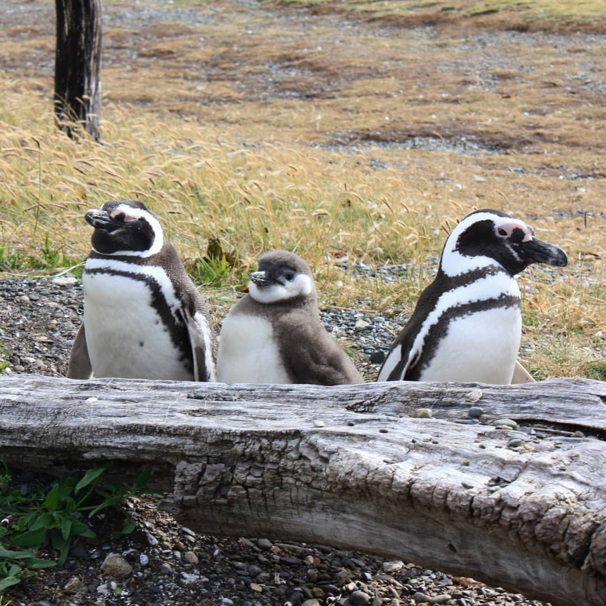
integration

Slide 38
Integration – where to put?
Sharpen only can be a replacement for existing post TAA sharpen passes.
Sharpening + upsampling can be used for dynamic resolution scaling.
On a single pass
General recommendation – after your post process chain and before your UI
Anti-Aliasing
Bloom and Tone mapping
CAS
Grain

Slide 39
Integration – where to put?
It is likely better to reduce the amount of film grain which happens before CAS (as CAS will amplify grain).
An alternative would be to add grain after CAS.
It is best to run CAS after tonemapping.
CAS can slightly alterate UI, so it‘s recommended to apply it before
Anti-Aliasing
Bloom and Tone mapping
CAS
Grain

Slide 40
Integration - General
CAS is designed to run as a compute shader
Should run either in a 32-bit, CasFilter(), or packed 16-bit, CasFilterH()
We recommend to use packed 16-bit for Vulkan® (if packed math is supported obv. ☺ )
And 32-bit for DX12 (for now)
32-bit form works on 8x8 tiles via one {64,1,1} threadgroup
→ Each thread works on one pixel per CasFilter() call
16-bit form works on a pair of 8x8 tiles in a 16x8 configuration via one {64,1,1}
→ Each thread works on two pixel per CasFilterH() call

Slide 41
Integration – CPU Side
Make sure <stdint.h> has already been included.
Setup pre-portability-header defines.
#define A_CPU 1
Include the portability header.
#include "ffx_a.h"
Include the CAS header.
#include "ffx_cas.h"
// FFX Cas
#include <stdint.h>
#define A_CPU
#include "ffx_a.h"
#include "ffx_cas.h"

Slide 42
Integration – CPU Side
A_STATIC void CasSetup(
outAU4 const0,
outAU4 const1,
// sharpness knob
// 0 := default (lower ringing)
// 1 := maximum (highest ringing)
AF1 sharpness,
AF1 inputSizeInPixelsX,
AF1 inputSizeInPixelsY,
AF1 outputSizeInPixelsX,
AF1 outputSizeInPixelsY){
// build constants
…
}
uint32_t m_const0[4];
uint32_t m_const1[4];
CasSetup(m_consts, m_consts,
0.0f, // Sharpness tuning knob (0.0 to 1.0).
920.0f, 1080.0f, // Example input size.
2560.0f, 1440.0f); // Example output size.

Slide 43
Integration – CPU Side
A_STATIC void CasSetup(
outAU4 const0,
outAU4 const1,
// sharpness knob
// 0 := default (lower ringing)
// 1 := maximum (highest ringing)
AF1 sharpness,
AF1 inputSizeInPixelsX,
AF1 inputSizeInPixelsY,
AF1 outputSizeInPixelsX,
AF1 outputSizeInPixelsY){
// build constants
…
}
uint32_t m_const0[4];
uint32_t m_const1[4];
CasSetup(m_consts, m_consts,
0.0f, // Sharpness tuning knob (0.0 to 1.0).
920.0f, 1080.0f, // Example input size.
2560.0f, 1440.0f); // Example output size.
Builds constants for input to the shader
Const0 contains the scaling terms
  depends on input and output size
Const1 contains the sharpness value
  And some additional information about the input and output size
It‘s possible to call CasSetup on the GPU too

Slide 44
Integration – CPU Side
Later dispatch the shader based on the amount of semi-persistent loop unrolling.
CAS is designed to run semi-persistent (aka loop unrolled) always.
Here is an example for running with the 16x16 (4-way unroll for 32-bit or 2-way unroll for 16-bit)
vkCmdDispatch(cmdBuf,(widthInPixels+15)/16,(heightInPixels+15)/16,1);
→ relies on how you distribute the workload to your threadgroups. If in any doubt, refer to the example ☺

Slide 45
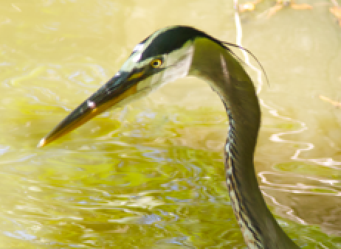
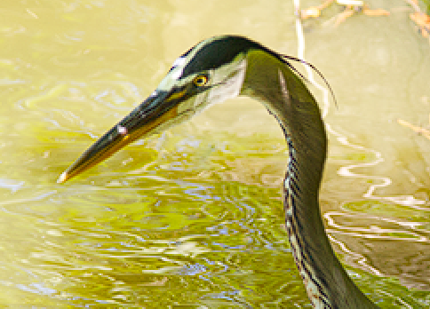
Integration – GPU Side
Create a shader to apply CAS that includes the exposed CAS headers
Fullscreen pass at pretty much the end of your pipeline
Pass takes an image + constants and outputs sharpened, potentially higher resolution image
CAS Compute Shader
Constants

Slide 46
Integration – GPU Side
Create a shader to apply CAS that includes the exposed CAS headers
Fullscreen pass at pretty much the end of your pipeline
Pass takes an image + constants and outputs sharpened, potentially higher resolution image
CAS Compute Shader
Constants
These are the constants created during CasSetup()

Slide 47
Integration – GPU Side
Setup layout for constants from CasSetup, e.g.:
layout(set=0,binding=2) uniform const_buffer
{
uvec4 const0;
uvec4 const1;
} cb;
Setup layout for input and output image
layout(set=0,binding=0,rgba16f)uniform image2D imgSrc;
layout(set=0,binding=1,rgba16f)uniform image2D imgDst;
Example here: images are of VK_FORMAT_R16G16B16A16_SFLOAT format

Slide 48
Integration – GPU Side
Setup pre-portability-header defines (sets up GLSL/HLSL path, etc.)
#define A_GPU 1
#define A_GLSL 1 // or #define A_HLSL 1
Include the portability header (or copy it in without an include).
#include <ffx_a.h>

Slide 49
Integration – GPU Side
Define the fetch function(s).
CasLoad() takes a 32-bit unsigned integer 2D coordinate and loads the color.
AF3 CasLoad(ASU2 p){return imageLoad(imgSrc,p).rgb;}
Define the input modifiers as nop's initially.
void CasInput(inout AF1 r,inout AF1 g,inout AF1 b){}
Include this CAS header file (or copy it in without an include).
#include <ffx_cas.h>

Slide 50
Integration – GPU Side
CasLoad() is used by the CasFilter() function, but needs to be defined manually.
Reason: may differ according to input format
Define the fetch function(s).
CasLoad() takes a 32-bit unsigned integer 2D coordinate and loads the color.
AF3 CasLoad(ASU2 p){return imageLoad(imgSrc,p).rgb;}
Define the input modifiers as nop's initially.
void CasInput(inout AF1 r,inout AF1 g,inout AF1 b){}
Include this CAS header file (or copy it in without an include).
#include <ffx_cas.h>

Slide 51
Integration – GPU Side
Will come later back to this in relation to input format!
Define the fetch function(s).
CasLoad() takes a 32-bit unsigned integer 2D coordinate and loads the color.
AF3 CasLoad(ASU2 p){return imageLoad(imgSrc,p).rgb;}
Define the input modifiers as nop's initially.
void CasInput(inout AF1 r,inout AF1 g,inout AF1 b){}
Include this CAS header file (or copy it in without an include).
#include <ffx_cas.h>

Slide 52
Integration – GPU Side
GLSL:
ASU2 := ivec2
AF1 := float
AF3 := vec3
Define the fetch function(s).
CasLoad() takes a 32-bit unsigned integer 2D coordinate and loads the color.
AF3 CasLoad(ASU2 p){return imageLoad(imgSrc,p).rgb;}
Define the input modifiers as nop's initially.
void CasInput(inout AF1 r,inout AF1 g,inout AF1 b){}
Include this CAS header file (or copy it in without an include).
#include <ffx_cas.h>
HLSL:
ASU2 := int2
AF1 := float
AF3 := float3

Slide 53
Integration – GPU Side
Example in shader integration for the semi-persistent 16x16 case for 32-bit using the faster quality option.
layout(local_size_x=64)in;
void main(){
Fetch constants from CasSetup().
AU4 const0=cb.const0;
AU4 const1=cb.const1;
Do remapping of local xy in workgroup for a more PS-like swizzle pattern.
gxy is the integer pixel position of the output image
AU2 gxy=ARmp8x8(gl_LocalInvocationID.x)+AU2(gl_WorkGroupID.x<<4u,gl_WorkGroupID.y<<4u);
Filter.
…

Slide 54
Integration – GPU Side
Simple remap 64x1 to 8x8 with rotated 2x2 pixel quads in quad linear.
LANE TO 8x8 MAPPING
===================
00 01 08 09 10 11 18 19
02 03 0a 0b 12 13 1a 1b
04 05 0c 0d 14 15 1c 1d
06 07 0e 0f 16 17 1e 1f
20 21 28 29 30 31 38 39
22 23 2a 2b 32 33 3a 3b
24 25 2c 2d 34 35 3c 3d
26 27 2e 2f 36 37 3e 3f
Example in shader integration for the semi-persistent 16x16 case for 32-bit using the faster quality option.
layout(local_size_x=64)in;
void main(){
Fetch constants from CasSetup().
AU4 const0=cb.const0;
AU4 const1=cb.const1;
Do remapping of local xy in workgroup for a more PS-like swizzle pattern.
gxy is the integer pixel position of the output image
AU2 gxy=ARmp8x8(gl_LocalInvocationID.x)+AU2(gl_WorkGroupID.x<<4u,gl_WorkGroupID.y<<4u);
Filter.
…

Slide 55
Integration – GPU Side
void CasFilter(
// Output values, non-vector so port between CasFilter() and CasFilterH() is easy.
out AF1 pixR,
out AF1 pixG,
out AF1 pixB,
// Integer pixel position in output.
AU2 ip,
// Constants generated by CasSetup().
AU4 const0,
AU4 const1,
// Must be a compile-time literal value, true = sharpen only (no resize).
AP1 noScaling){ … /* algorithm as explained before ☺ */ … }

Slide 56
Integration – GPU Side
AF4 c;
CasFilter(c.r,c.g,c.b,gxy,const0,const1,false);
imageStore(imgDst,ASU2(gxy),c);
gxy.x+=8u;
CasFilter(c.r,c.g,c.b,gxy,const0,const1,false);
imageStore(imgDst,ASU2(gxy),c);
gxy.y+=8u;
CasFilter(c.r,c.g,c.b,gxy,const0,const1,false);
imageStore(imgDst,ASU2(gxy),c);
gxy.x-=8u;
CasFilter(c.r,c.g,c.b,gxy,const0,const1,false);
imageStore(imgDst,ASU2(gxy),c);
…
}
8x8 | 8x8
8x8 | 8x8

Slide 57
Integration – GPU Side - Packed
Setup pre-portability-header defines (sets up GLSL/HLSL path, packed math support, etc.)
#define A_GPU 1
#define A_GLSL 1 // or #define A_HLSL 1
#define A_HALF 1
#define CAS_PACKED_ONLY 1
Include the portability header (or copy it in without an include).
#include <ffx_a.h>

Slide 58
Integration – GPU Side - Packed
Define the fetch function(s).
CasLoadH() is the 16-bit version taking 16-bit unsigned integer 2D coordinate and loading 16-bit float color.
AH3 CasLoadH(ASW2 p){return AH3(imageLoad(imgSrc,ASU2(p)).rgb);}
Define the input modifiers as nop's initially.
void CasInputH(inout AH2 r,inout AH2 g,inout AH2 b){}
Include this CAS header file (or copy it in without an include).
CAS_PACKED_ONLY needs to be defined already!
#include <ffx_cas.h>

Slide 59
Integration – GPU Side - Packed
Example for semi-persistent 16x16 but this time for packed math.
layout(local_size_x=64)in;
void main(){
Fetch constants from CasSetup().
AU4 const0=cb.const0;
AU4 const1=cb.const1;
Do remapping of local xy in workgroup for a more PS-like swizzle pattern.
gxy is the integer pixel position of the output image.
AU2 gxy=ARmp8x8(gl_LocalInvocationID.x)+AU2(gl_WorkGroupID.x<<4u,gl_WorkGroupID.y<<4u);
Filter.
…

Slide 60
Integration – GPU Side - Packed
void CasFilterH(
// Output values are for 2 8x8 tiles in a 16x8 region.
// pix<R,G,B>.x = right 8x8 tile
// pix<R,G,B>.y = left 8x8 tile
// This enables later processing to easily be packed as well.
out AH2 pixR,
out AH2 pixG,
out AH2 pixB,
// Integer pixel position in output.
AU2 ip,
// Constants generated by CasSetup().
AU4 const0,
AU4 const1,
// Must be a compile-time literal value, true = sharpen only (no resize).
AP1 noScaling){… /* algorithm as explained before ☺ */ … }

Slide 61
Integration – GPU Side - Packed
// Can be used to convert from packed SOA to AOS for store.
void CasDepack(out AH4 pix0,out AH4 pix1,AH2 pixR,AH2 pixG,AH2 pixB){
#ifdef A_HLSL
// Invoke a slower path for DX only, since it won't allow uninitialized values.
pix0.a=pix1.a=0.0;
#endif
pix0.rgb=AH3(pixR.x,pixG.x,pixB.x);
pix1.rgb=AH3(pixR.y,pixG.y,pixB.y);}

Slide 62
Integration – GPU Side - Packed
AH4 c0,c1; AH2 cR,cG,cB;
CasFilterH(cR,cG,cB,gxy,const0,const1,false);
Extra work integrated after CAS would go here.
...
Suggest only running CasDepack() right before stores, to maintain packed math for any work after CasFilterH().
CasDepack(c0,c1,cR,cG,cB);
imageStore(imgDst,ASU2(gxy),AF4(c0));
imageStore(imgDst,ASU2(gxy)+ASU2(8,0),AF4(c1));
gxy.y+=8u;
CasFilterH(cR,cG,cB,gxy,const0,const1,false);
...
CasDepack(c0,c1,cR,cG,cB);
imageStore(imgDst,ASU2(gxy),AF4(c0));
imageStore(imgDst,ASU2(gxy)+ASU2(8,0),AF4(c1));
}
16x8
16x8

Slide 63
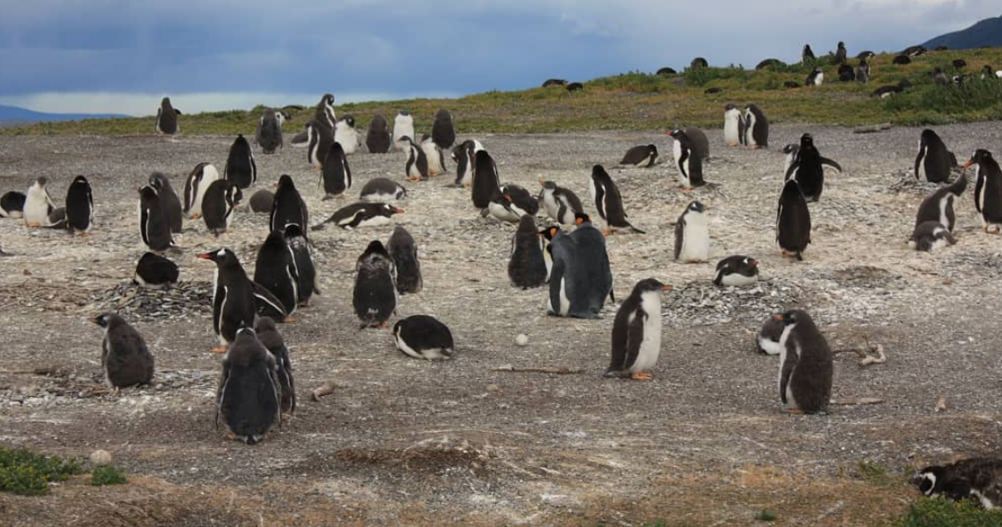
Input

Slide 64
Input - General
Input must range between {0 to 1} for each color channel.
CAS output will be {0 to 1} ranged as well.
CAS is designed to be a linear filter.
This filter does not function well on sRGB or gamma 2.2 non-linear data.
This filter does not function on PQ non-linear data.
Due to the shape of PQ, the positive side of the ring created by the negative lobe tends to become over-bright.

Slide 65
Input - General
CAS sharpen only does 5 loads, so any conversion applied during CasLoad() or CasInput() has
a 5 load * 3 channel = 15x cost amplifier.
input conversions need to be factored into the prior pass's output.
But if necessary use CasInput() instead of CasLoad(), as CasInput() works with packed color.
For CAS with scaling the amplifier is 12 load * 3 channel = 36x cost amplifier.
Any conversion applied to output has a 3x cost amplifier (3 color channels).
Output conversions are substantially less expensive.
Added VALU ops due to conversions will have visible cost as this shader is already quite
VALU heavy.

Slide 66
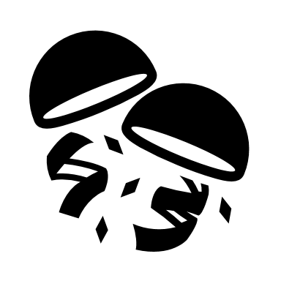
Input Format – FP16
FP16 with all non-negative values ranging {0 to 1}
-> use as is, filter is designed for linear input and output ranging {0 to 1}

Slide 67
Input Format – UNORM
UNORM with linear conversion approximation
Can be used for both sRGB or FreeSync2 native gamma 2.2 cases
Load/store with either 10:10:10:2 UNORM or 8:8:8:8 UNORM
Use gamma 2.0 conversion in CasInput() as an approximation:
void CasInput(inout AF1 r,inout AF1 g,inout AF1 b){r*=r;g*=g;b*=b;}
CasInput() is for optional input transforms.
Do linear to gamma 2.0 before the store in your shader:
c.r=sqrt(c.r);c.g=sqrt(c.g);c.b=sqrt(c.b);
imageStore(imgDst,ASU2(gxy),c);

Slide 68
Input Format – UNORM Packed
UNORM with linear conversion approximation
Can be used for both sRGB or FreeSync2 native gamma 2.2 cases
Use gamma 2.0 conversion in CasInputH() as an approximation:
void CasInputH(inout AH2 r,inout AH2 g,inout AH2 b){r*=r;g*=g;b*=b;}
Do linear to gamma 2.0 before the store in your shader
CasFilterH(cR,cG,cB,gxy,const0,const1,false);
cR=sqrt(cR);cG=sqrt(cG);cB=sqrt(cB);
CasDepack(c0,c1,cR,cG,cB);
imageStore(img[0],ASU2(gxy),AF4(c0));
imageStore(img[0],ASU2(gxy+AU2(8,0)),AF4(c1));

Slide 69
Input Format – SRGB
Use texelFetch() with sRGB format (VK_FORMAT_R8G8B8A8_SRGB) for loads (gets linear into shader).
Store to destination using UNORM (not sRGB) stores and do the linear to sRGB conversion in the shader.
AF3 CasLoad(ASU2 p){return texelFetch(texSrc,p,0).rgb;}
Add before store in shader:
Do linear to sRGB before store
c.r=AToSrgbF1(c.r);
c.g=AToSrgbF1(c.g);
c.b=AToSrgbF1(c.b);
imageStore(imgDst,ASU2(gxy),c);

Slide 70
Input Format – SRGB Packed
AH3 CasLoadH(ASW2 p){return AH3(texelFetch(texSrc, ASU2(p),0).rgb);}
Add before store in shader:
Do linear to sRGB before store
CasFilterH(cR,cG,cB,gxy,const0,const1,false);
cR=AToSrgbH2(cR);
cG=AToSrgbH2(cG);
cB=AToSrgbH2(cB);
CasDepack(c0,c1,cR,cG,cB);
imageStore(img[0],ASU2(gxy),AF4(c0));
imageStore(img[0],ASU2(gxy+AU2(8,0)),AF4(c1));

Slide 71
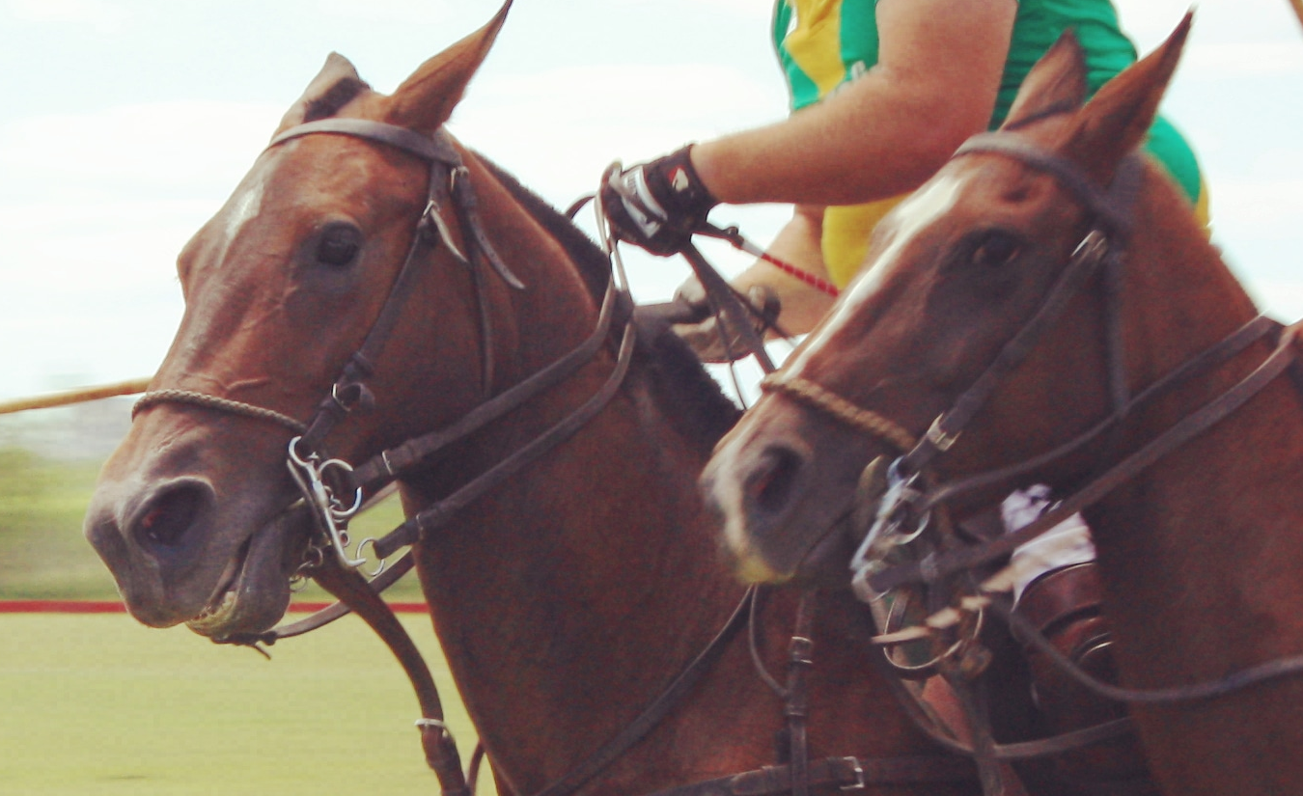
Performance

Slide 72
Performance
As of current testing, sharpen-only takes
on RX 5700 XT for 1080p unpacked.
Numbers are expected to scale fairly linearly with resolution
Sharpen + Scaling: depends on configuration
< 100 µs

Slide 73

Examples

Slide 74

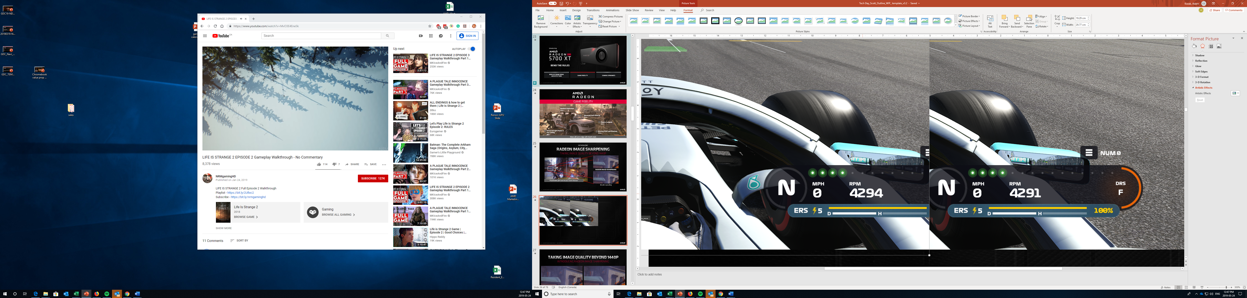
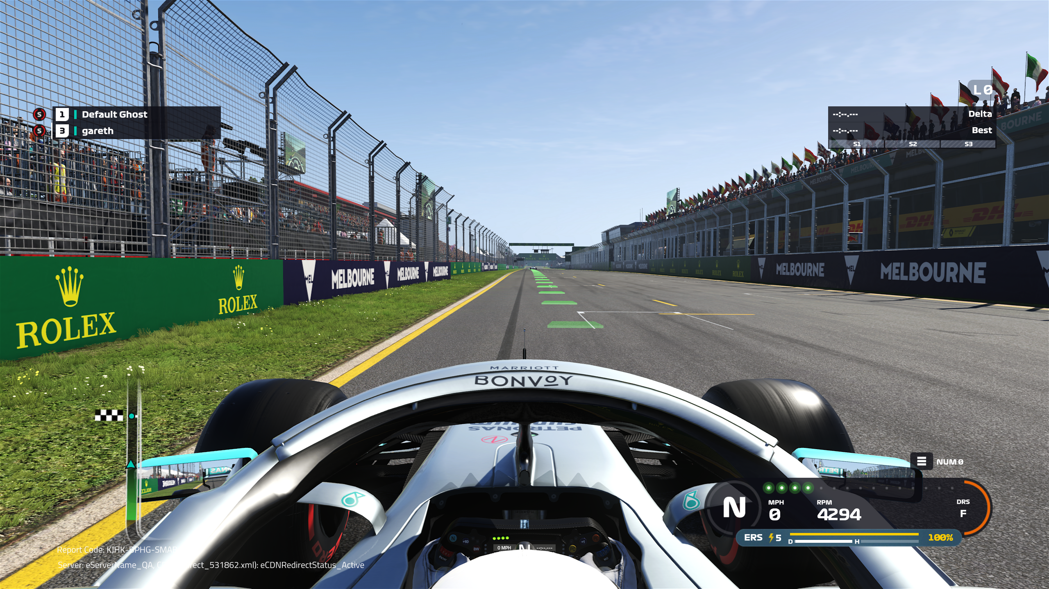
F1 2019

Slide 75
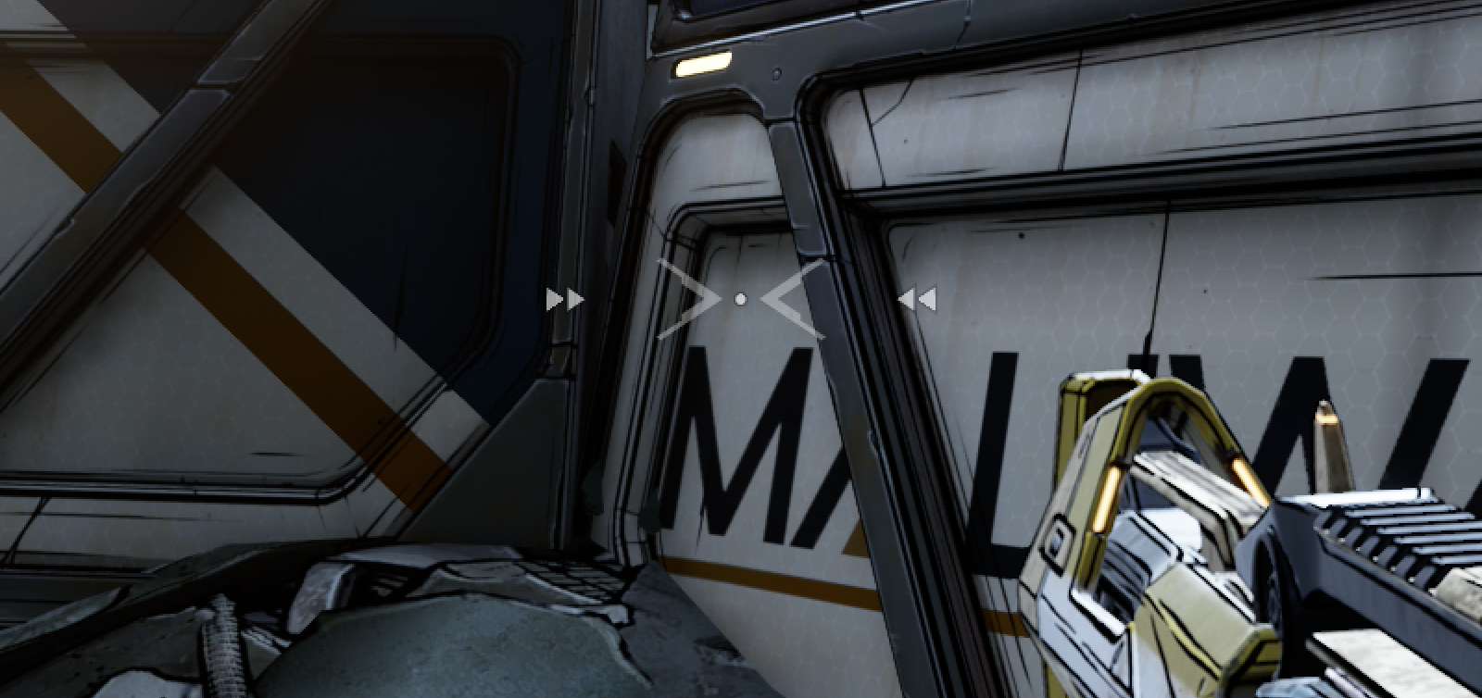
Borderlands 3

Slide 76
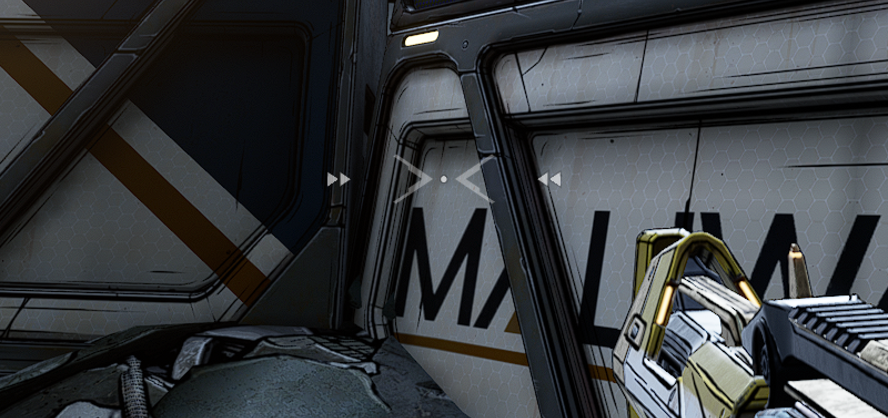
Borderlands 3

Slide 77
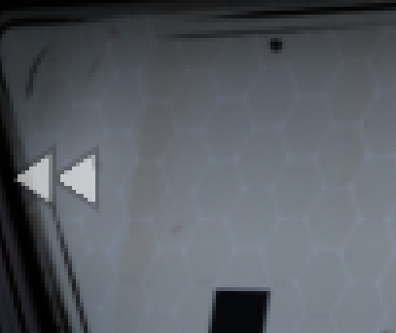
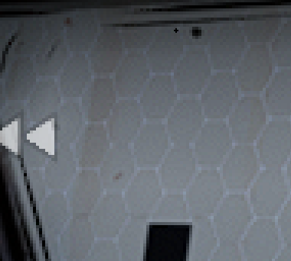
Borderlands 3

Slide 78
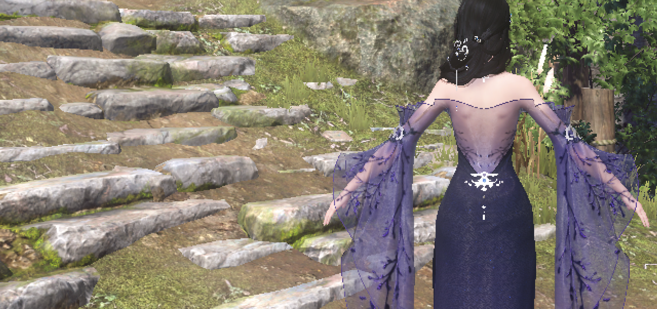
Ni Shui Han – 100% Zoom

Slide 79

Ni Shui Han – 100% Zoom

Slide 80
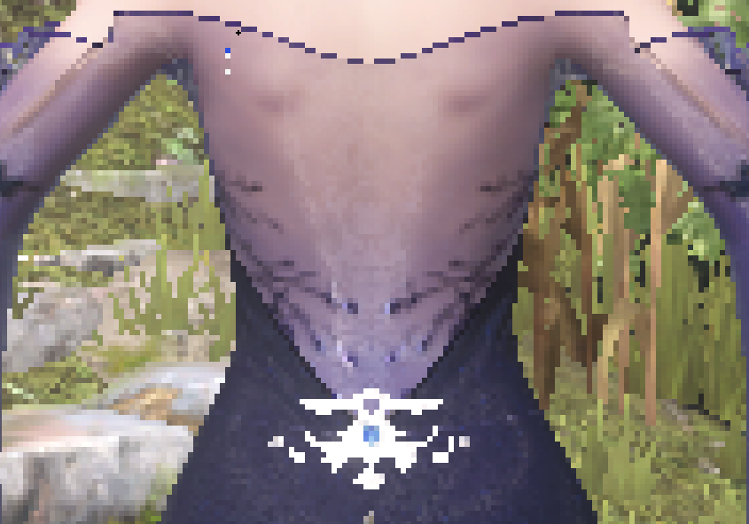
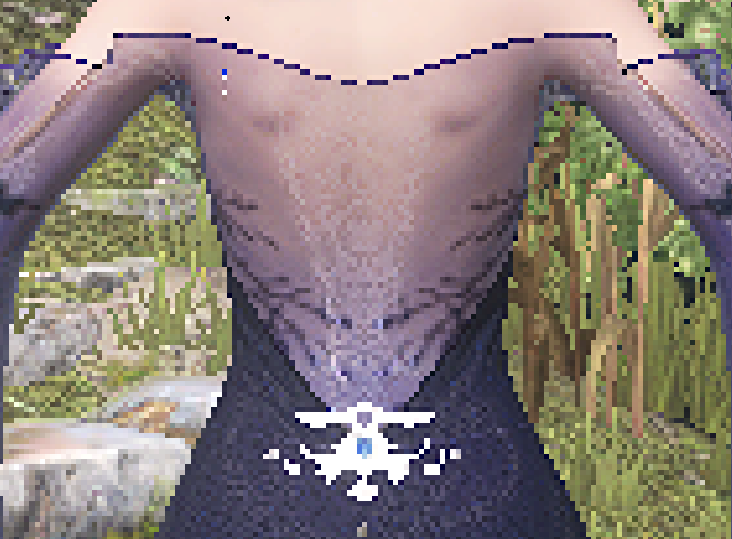
Ni Shui Han

Slide 81

Rage 2
Notes:
720p no cas

Slide 82

Rage 2
Notes:
720p cas

Slide 83
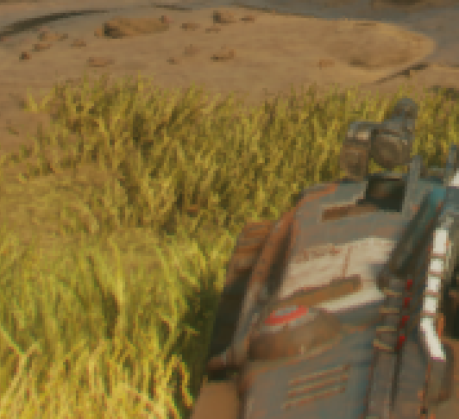
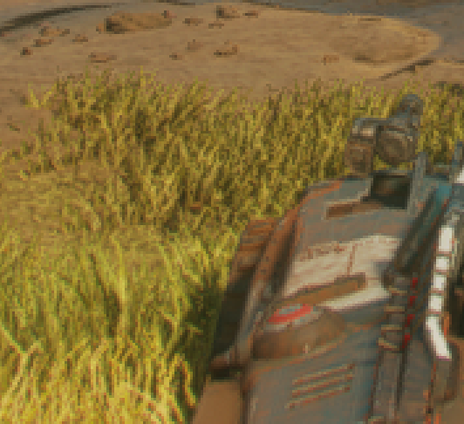
Rage 2
Notes:
720p cas

Slide 84
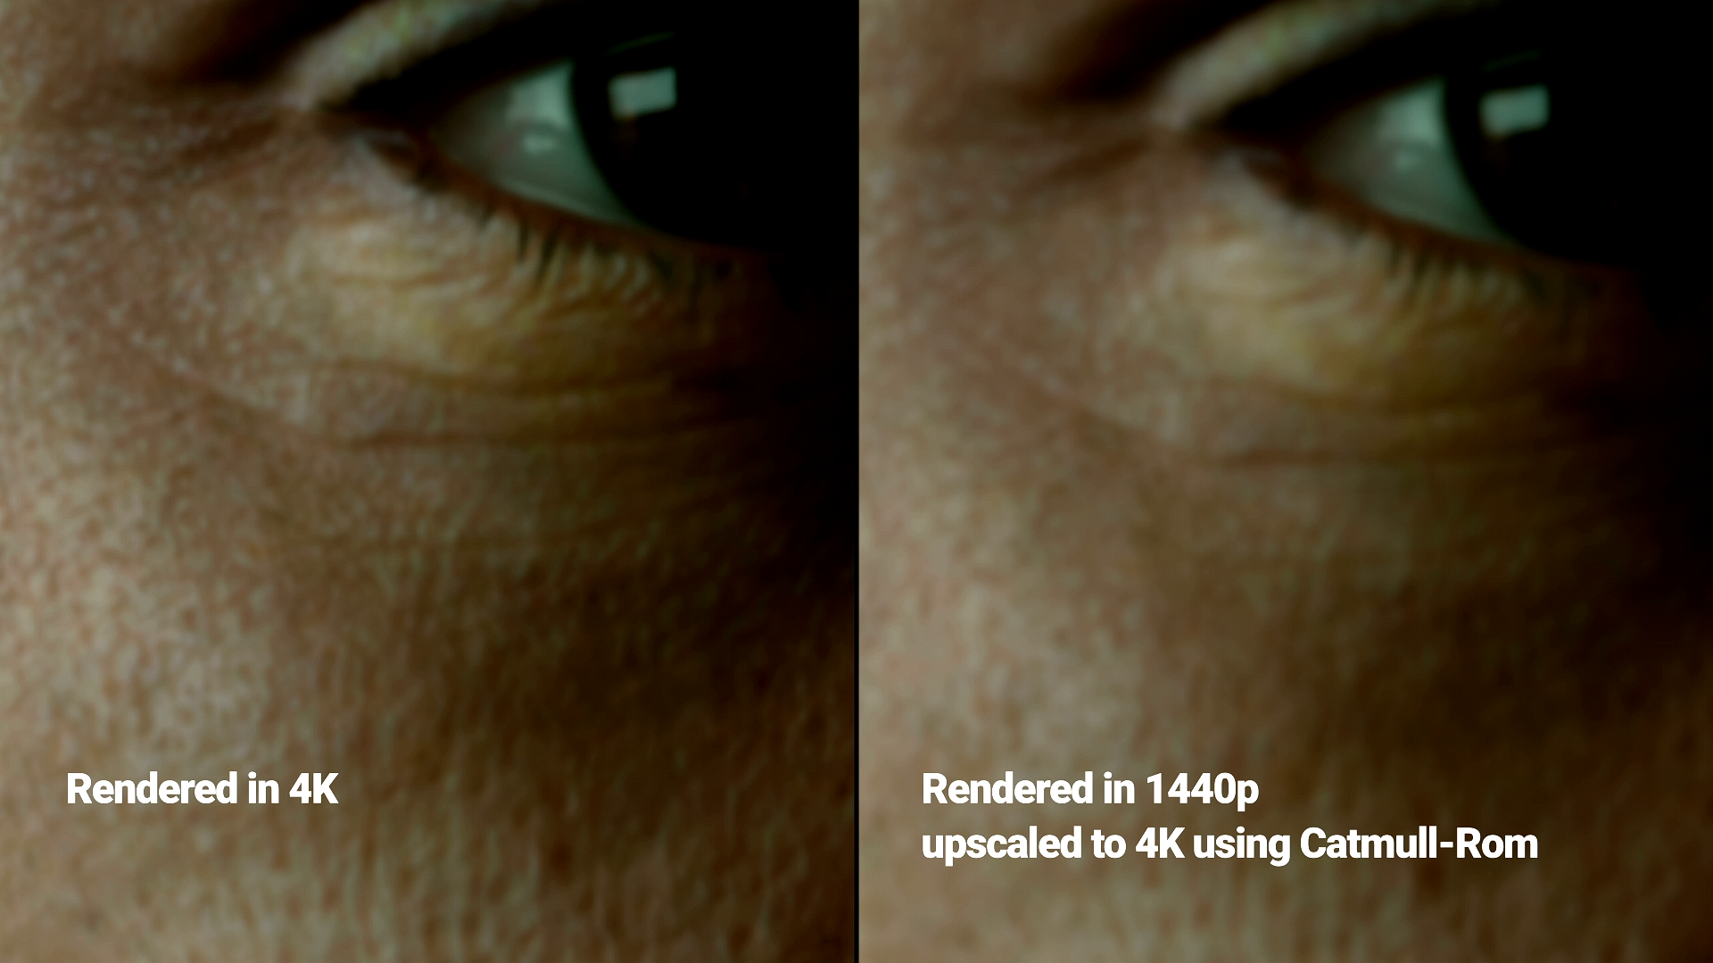
Unity Demo

Slide 85
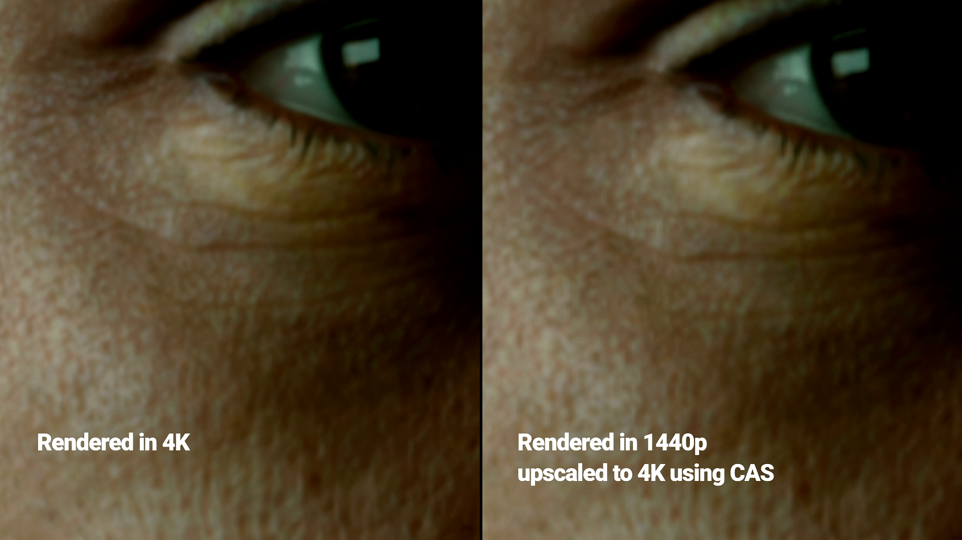
Unity Demo

Slide 86
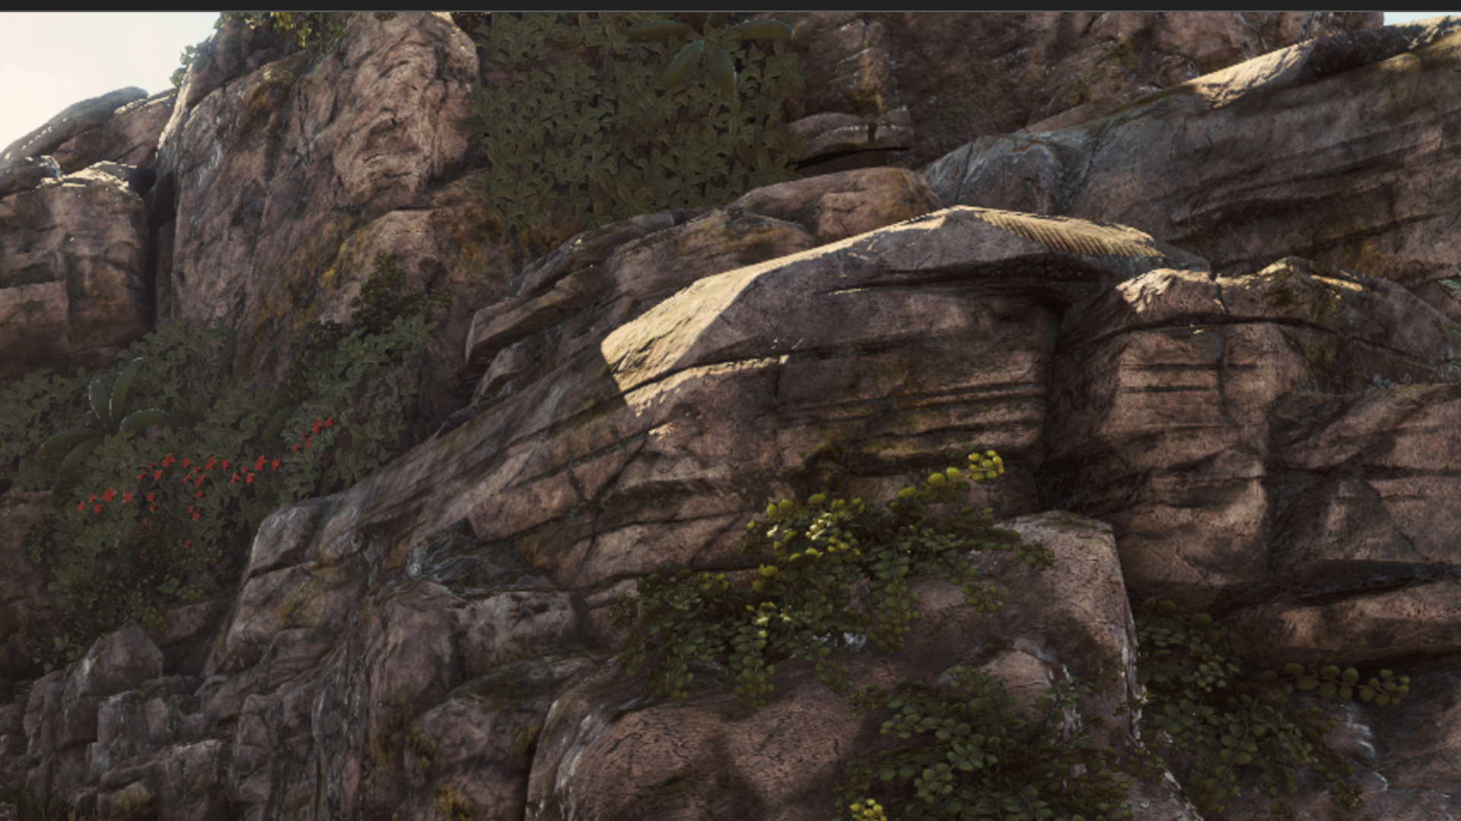
Strange Brigade
2560 scaled to 3840 no CAS

Slide 87

Strange Brigade
2560 scaled to 3840 with CAS

Slide 88

Strange Brigade
3840 native

Slide 89

Thanks to
Timothy Lottes
Adam Sawicki
Marcus Svensson
Ihor Szlachtycz
Nick Thibieroz

Slide 90

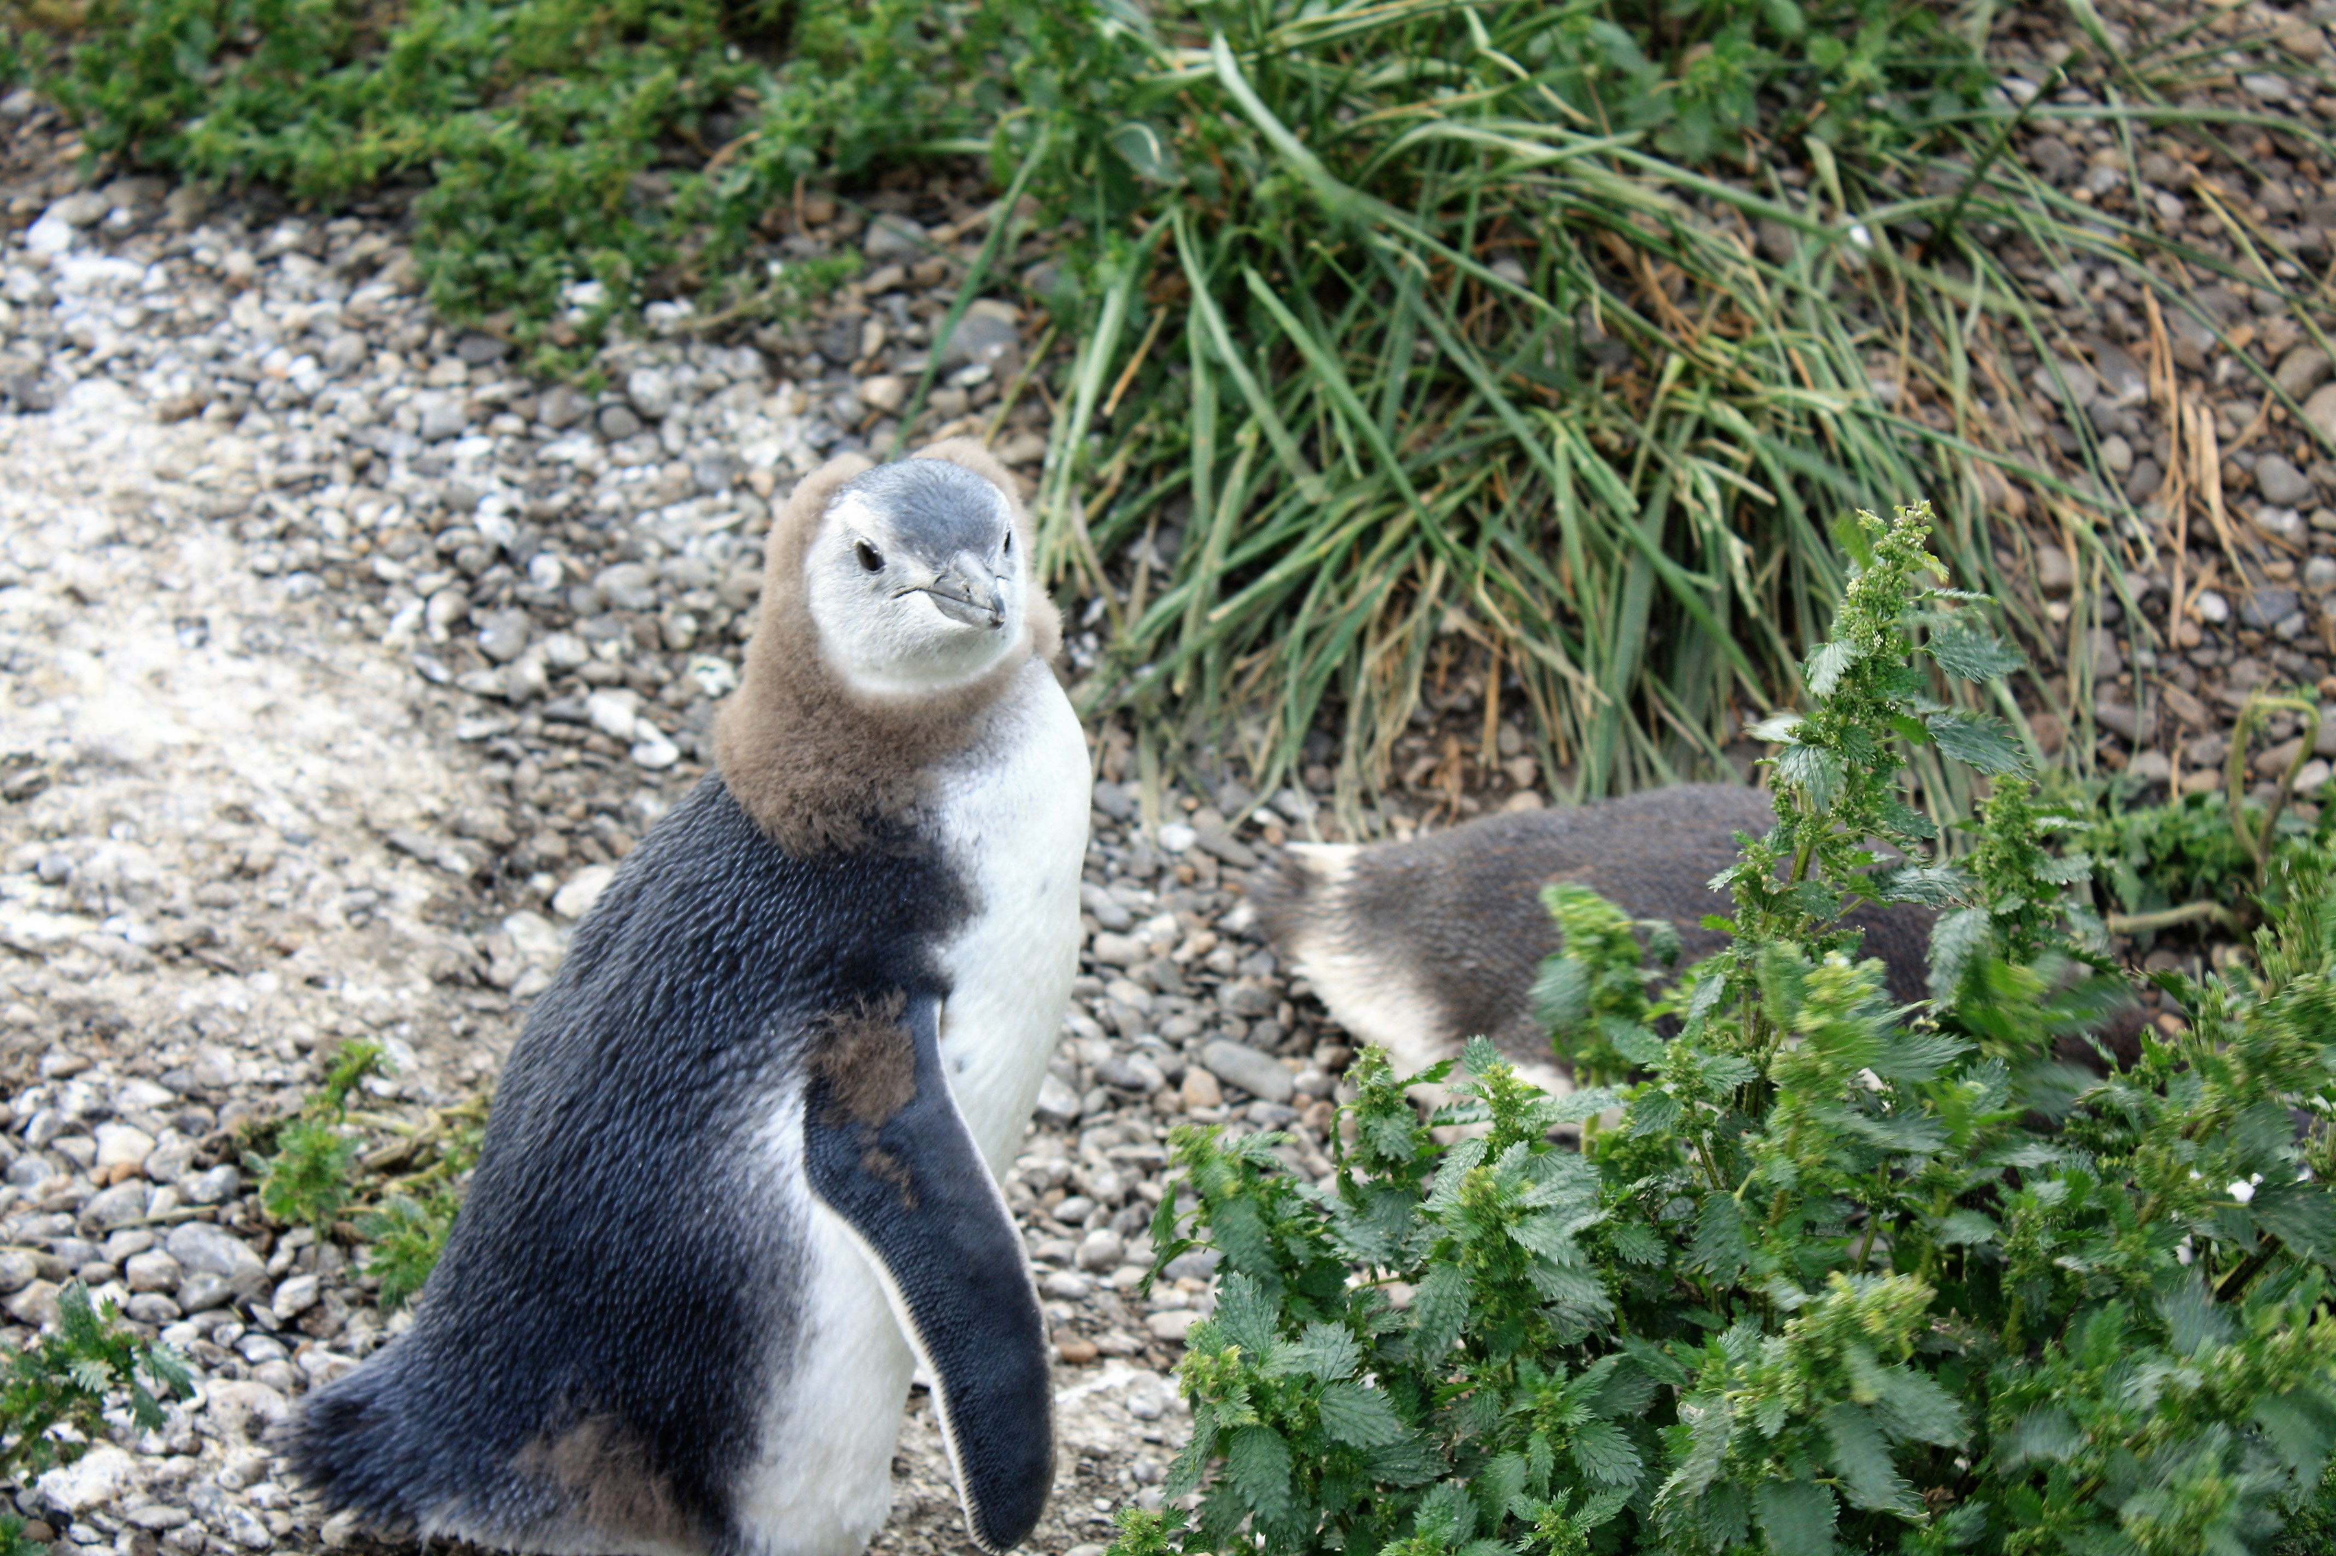
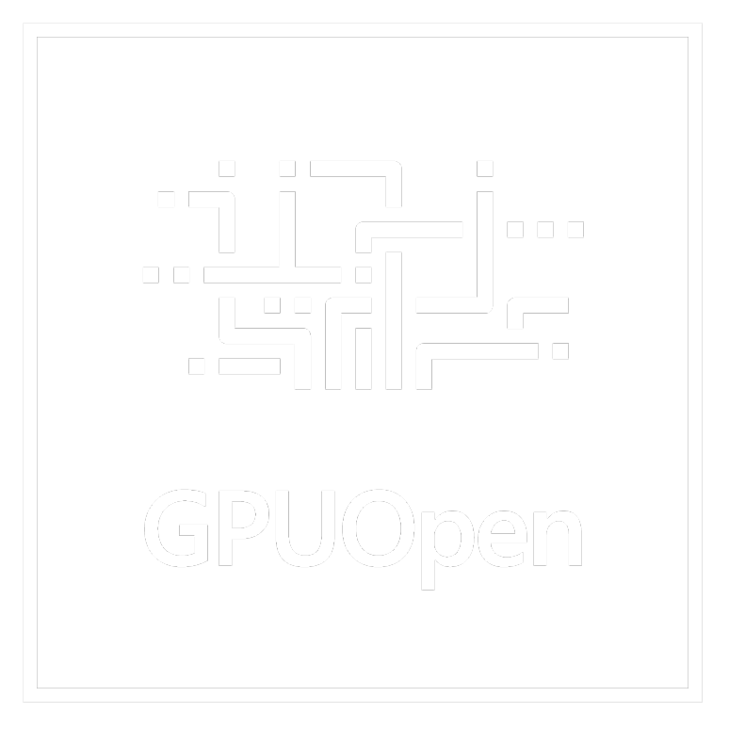
Q&A
lou.kramer@amd.com
@lou_auroyup
https://gpuopen.com/

Slide 91
Disclaimer & Attribution
The information presented in this document is for informational purposes only and may contain technical inaccuracies, omissions and typographical errors.
The information contained herein is subject to change and may be rendered inaccurate for many reasons, including but not limited to product and roadmap changes, component and motherboard version changes, new model and/or product releases, product differences between differing manufacturers, software changes, BIOS flashes, firmware upgrades, or the like. AMD assumes no obligation to update or otherwise correct or revise this information. However, AMD reserves the right to revise this information and to make changes from time to time to the content hereof without obligation of AMD to notify any person of such revisions or changes.
AMD MAKES NO REPRESENTATIONS OR WARRANTIES WITH RESPECT TO THE CONTENTS HEREOF AND ASSUMES NO RESPONSIBILITY FOR ANY INACCURACIES, ERRORS OR OMISSIONS THAT MAY APPEAR IN THIS INFORMATION.
AMD SPECIFICALLY DISCLAIMS ANY IMPLIED WARRANTIES OF MERCHANTABILITY OR FITNESS FOR ANY PARTICULAR PURPOSE. IN NO EVENT WILL AMD BE LIABLE TO ANY PERSON FOR ANY DIRECT, INDIRECT, SPECIAL OR OTHER CONSEQUENTIAL DAMAGES ARISING FROM THE USE OF ANY INFORMATION CONTAINED HEREIN, EVEN IF AMD IS EXPRESSLY ADVISED OF THE POSSIBILITY OF SUCH DAMAGES.
ATTRIBUTION
© 2019 Advanced Micro Devices, Inc. All rights reserved. AMD, the AMD Arrow logo, RadeonTM and combinations thereof are trademarks of Advanced Micro Devices, Inc. in the United States and/or other jurisdictions. Vulkan® is a registered trademark of the Khronos Group Inc. Other names are for informational purposes only and may be trademarks of their respective owners.

